Slide 1

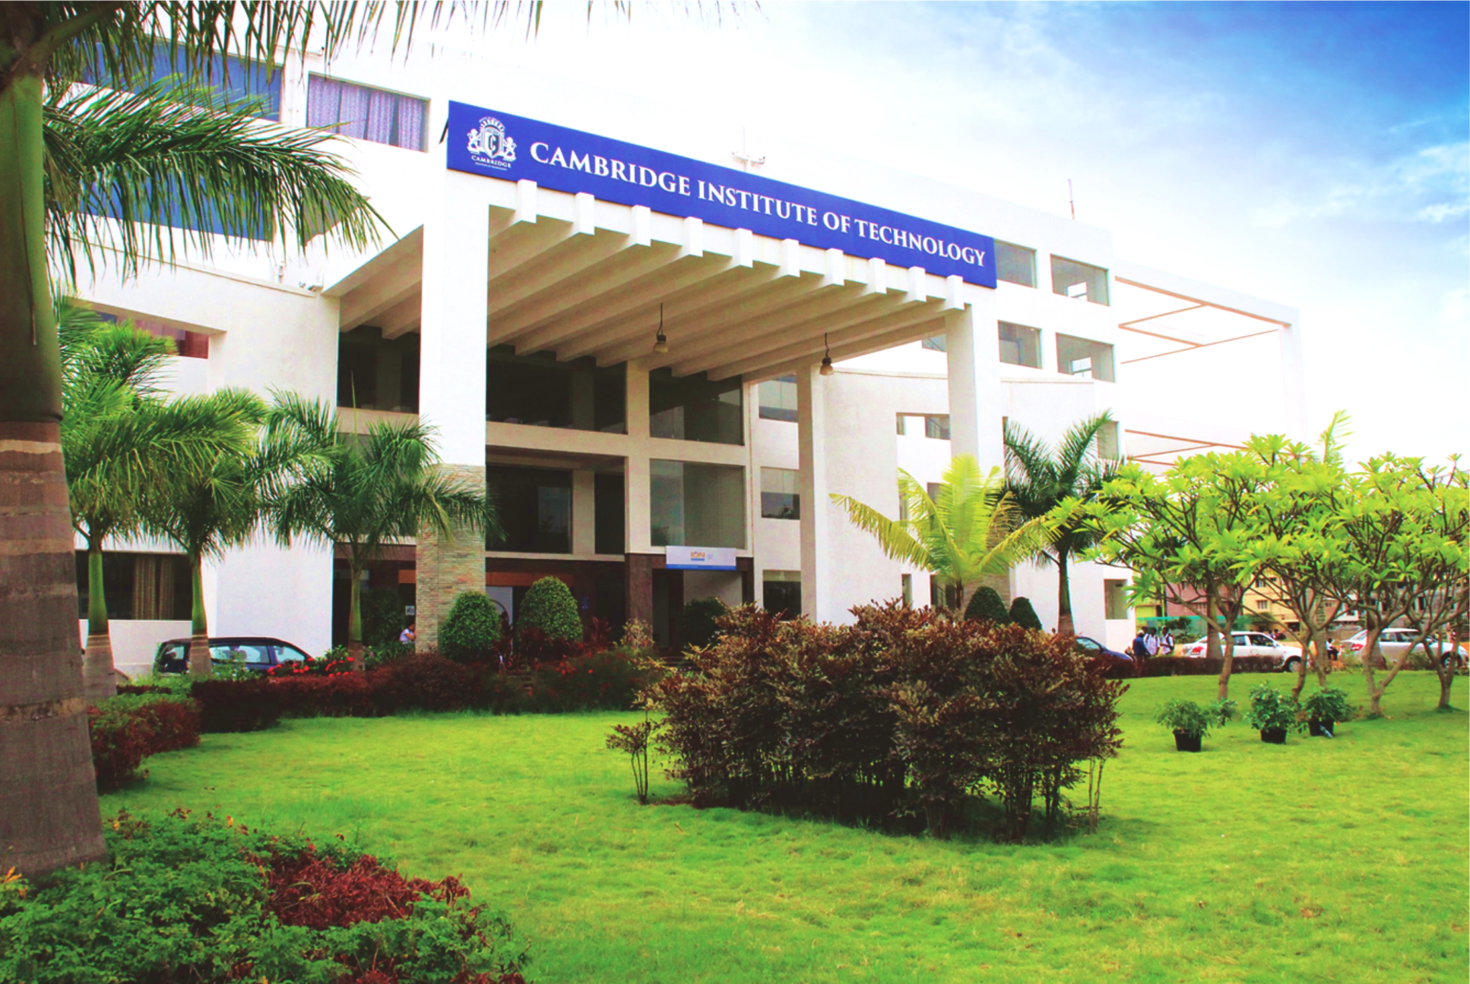
www.cambridge.edu.in
Machine Learning Project
Subject Code:21AIMP67
Project Name:
Cartoon Image Generator
Presented By :
KEERTHANA RS 1CD21AI024
RAMYA P 1CD21AI045
Department of Artificial Intelligence and Machine Learning

Slide 2
Abstract
Cartoon image generators leverage advanced image processing and machine learning techniques to transform real-world images into stylized cartoon representations. Utilizing methods like edge detection, color quantization, and neural networks, these tools can simplify color palettes and enhance edges to create a cartoon-like effect. They have broad applications in entertainment, education, art, and marketing. The main challenges include maintaining original features, effective style transfer, and high computational requirements. Despite these challenges, cartoon image generators offer innovative creative possibilities and continue to evolve with technological advancements.
Department of Artificial Intelligence and Machine Learning www.Cambridge.edu.in

Slide 3
Introduction
In recent years, the field of image processing and computer vision has seen remarkable advancements, particularly with the advent of deep learning techniques. One of the fascinating applications of these techniques is image style transfer, where the goal is to transform an image's style while preserving its content. This project focuses on cartoon image generation using AnimeGAN, a specialized Generative Adversarial Network (GAN) designed to convert real-world images into anime-style artworks. AnimeGAN is a machine learning model that converts real photos into anime-style images using generative adversarial networks (GANs). It comprises two main parts: the generator, which creates anime-style images, and the discriminator, which evaluates their authenticity. During training, the model learns from a dataset of real and anime images. The generator improves its output based on feedback from the discriminator. Over time, this process helps the generator produce realistic anime images from real photos.
Department of Artificial Intelligence and Machine Learning www.Cambridge.edu.in

Slide 4
Problem Statement
“ The primary challenge lies in ensuring the generated images maintain high visual fidelity and artistic consistency while effectively capturing the nuances of the input images. Ultimately, the goal is to provide a robust tool for artists, designers, and enthusiasts to create high-quality cartoon images effortlessly from real photographs.”
Department of Artificial Intelligence and Machine Learning www.Cambridge.edu.in

Slide 5
Objectives
The primary objectives of this project are:
Implement AnimeGAN
Optimize Performance
Preserve Content
Evaluate Quality
User-Friendly Interface
Department of Artificial Intelligence and Machine Learning www.Cambridge.edu.in

Slide 6
Literature Survey
SL NO | PAPER TITILE | JOURNAL NAME | AUTHOR | DESCRIPTION | PROS | CONS
1 | Cartoonizing the Image | International Journal of Advanced Trends in Computer Science and Engineering. | MD. Salar Mohammad Bollepalli Pranitha Shivani Goud Pandula Pulakanti Teja Sree | Processing technique is used to cartoonize an image. Image Processing-In the field of the research processing of an image consisting of identifying an object in an image identify the dimensions , no of objects , changing the images to blur effect and such effects are highly appreciated in the modern era of media and communication. | Object Identification. Dimensional Analysis. Versatile Effects. Enhanced Visual Quality. Grid Examination. | Complexity. Pixel Manipulation. Quality Variability. Technical Expertise. Potential Artifacts.
2 | Cartoonizer: Convert Images and Videos to Cartoon-Style Images and Videos. | International Journal of Research in Engineering, Science and Management. | S. Rajatha Anusha Shrikant Makkigadde Neha L. Kanchan Sapna K. Janardhana Bhat | Cartoon GAN , where GAN stands for Generative Adversarial Network is used to transform images (snapshots) to the finest cartooned image(animated image). With the help of the loss function and of two types named as Adversarial loss and content loss , we got a flexible as well as a clear edge defined images. Also with the help of CV2 which is Computer Vision , we have transformed video into animation(cartoonized video). | High-Quality Transformation. Flexibility and Clarity. Video Cartoonization. Automation and Efficiency. Wide Applicability. | Computational Intensity. Technical Complexity. Quality Control. Dependency on Training Data. Scalability Challenges.
Department of Artificial Intelligence and Machine Learning www.Cambridge.edu.in

Slide 7
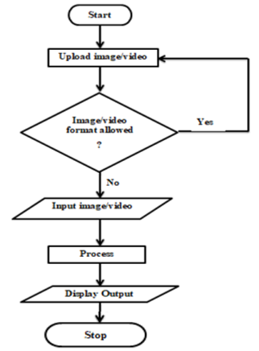
Methodology
Department of Artificial Intelligence and Machine Learning www.Cambridge.edu.in

Slide 8
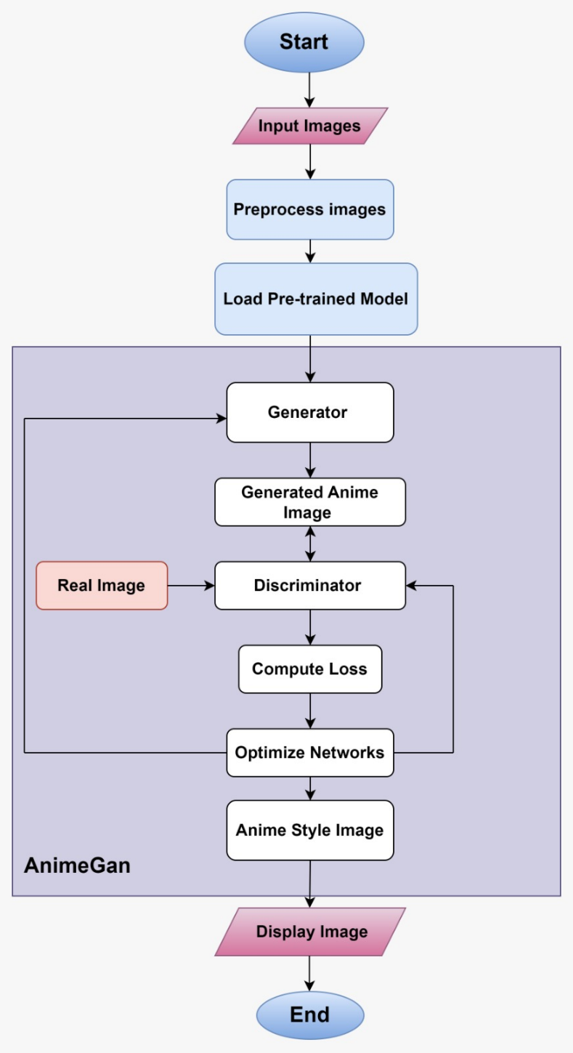
System Architecture
Department of Artificial Intelligence and Machine Learning www.Cambridge.edu.in

Slide 9
Tools and Technologies
Hardware Requirements:
Computer with a GPU
2. Sufficient RAM
3. Storage Space
Software Requirements:
Operating System
Programming Languages
Libraries and Frameworks:
i. TensorFlow or PyTorch
ii. OpenCV
iii. Numpy
iv. Matplotlib or Seaborn
4. Deep Learning Models
i. Generative Adversarial Networks (GANs)
ii. Pre-trained Models
5. Dataset
Department of Artificial Intelligence and Machine Learning www.Cambridge.edu.in

Slide 10
Implementation
1. Set Up the Environment
Install Dependencies: Ensure you have all necessary libraries installed. This usually includes TensorFlow or PyTorch, OpenCV, and other relevant packages.
Download the Model: Download the pretrained model from Kaggle. This typically involves setting up a Kaggle API token to access the dataset.
2. Load the Pretrained Model
Load the Model Weights: Use the appropriate framework (TensorFlow/PyTorch) to load the pretrained model weights.
Prepare the Model: If necessary, adjust the model to fit your specific requirements, such as input size.
Department of Artificial Intelligence and Machine Learning www.Cambridge.edu.in

Slide 11
Cont..
3. Preprocess Input Images
Image Normalization: Scale image pixel values to the range expected by the model.
Resizing: Ensure input images are resized to the dimensions required by the model.
4. Generate Cartoon Images
Pass Images Through the Model: Use the loaded model to process input images and generate cartoonized outputs.
Post-Processing: Apply any additional filters or enhancements as needed.
5. Evaluate and Test
Visual Inspection: Check the quality of the generated cartoon images.
Metric Evaluation: Optionally, use quantitative metrics to assess performance.
Department of Artificial Intelligence and Machine Learning www.Cambridge.edu.in

Slide 12
Cont..
6. Deploy the Application
API or Interface: Create an interface for users to upload images and receive cartoonized results.
Web Deployment: Use a web framework (e.g., Flask, Django) to serve the model.
Department of Artificial Intelligence and Machine Learning www.Cambridge.edu.in

Slide 13
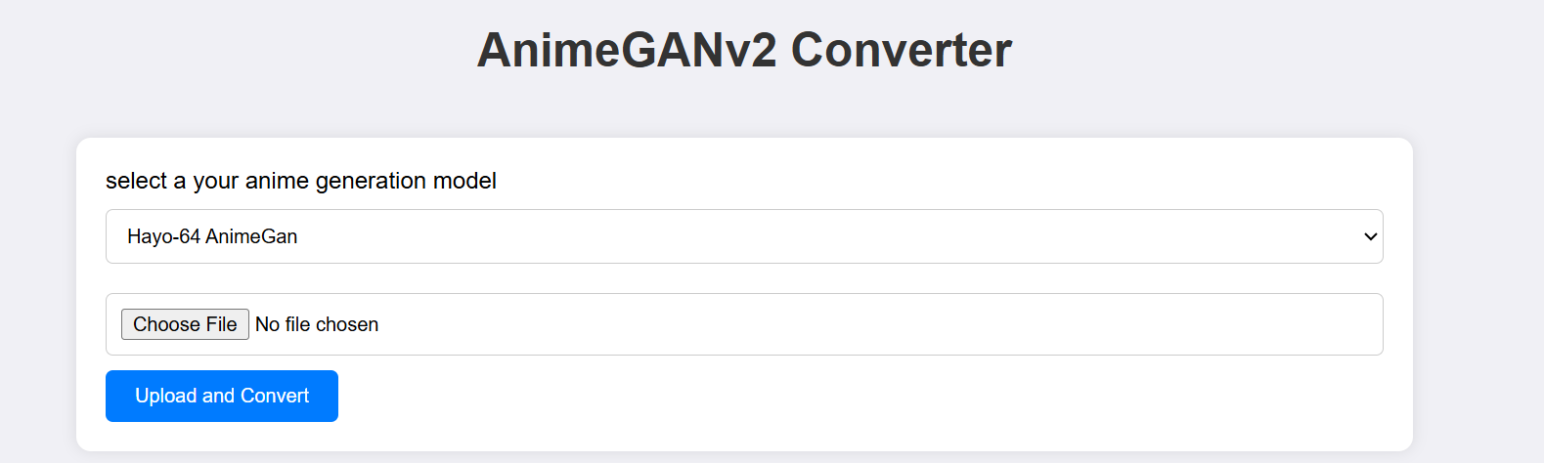
Result
Department of Artificial Intelligence and Machine Learning www.Cambridge.edu.in

Slide 14
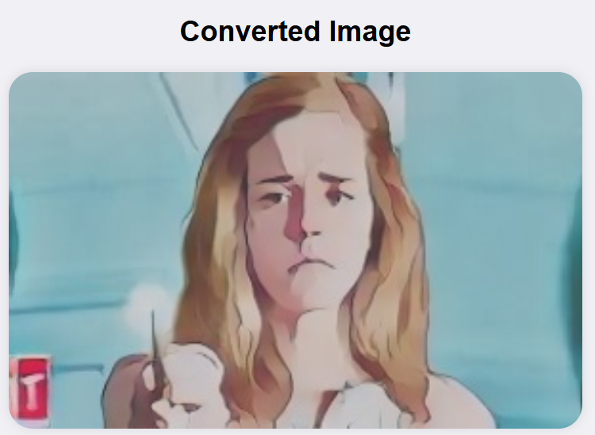
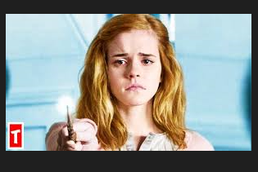
Original Image
Department of Artificial Intelligence and Machine Learning www.Cambridge.edu.in

Slide 15
Conclusion
The project on cartoon image generation using AnimeGAN demonstrates the power and potential of deep learning and Generative Adversarial Networks (GANs) in transforming real-world images into visually appealing anime-style artworks. By leveraging the architecture of AnimeGAN, the project successfully automates the process of image style transfer, providing a valuable tool for artists, content creators, and enthusiasts. The cartoon image generation project using AnimeGAN has demonstrated its effectiveness in transforming real-world images into high-quality anime-style artworks. The generated images exhibit excellent visual quality, preserve the content of the original images, and accurately capture the stylistic features of anime. With ongoing improvements and optimizations, this project holds great potential for various applications in entertainment, social media, digital marketing, and personal projects, providing a powerful tool for creative expression and digital art creation.
Department of Artificial Intelligence and Machine Learning www.Cambridge.edu.in

Slide 16
Future Work
Enhanced Realism and Detail: Advances in AI and machine learning will enable cartoon image generators to create highly detailed and realistic images, pushing the boundaries of what is traditionally considered a "cartoon."
Greater Customization: Future generators will offer more sophisticated customization options, allowing users to specify intricate details such as character emotions, clothing, backgrounds, and artistic styles.
Dynamic Animations: Beyond static images, future work will likely include the ability to generate dynamic, animated sequences, enabling users to create full-length animations and short films with minimal effort.
User-Friendly Interfaces: Development will focus on making these tools more intuitive and accessible to a broader audience, including those without technical expertise, fostering creativity across all skill levels.
Interactivity and Real-Time Editing: Future cartoon image generators may feature real-time editing capabilities, allowing users to interact with their creations as they build them, making the creative process more interactive and engaging.
Department of Artificial Intelligence and Machine Learning www.Cambridge.edu.in

Slide 17
References
[1] MD. Salar Mohammad, Bollepalli Pranitha,Shivani Goud Pandula, Pulakanti Teja Sree.(2021). “Cartoonizing the Image” an International Journal of Advanced Trends in Computer Science and Engineering, Volume 10,No.4, July – August 2021.
[2] S. Rajatha, Anusha Shrikant Makkigadde, Neha L. Kanchan, Sapna, K. Janardhana Bhat,”Cartoonizer: Convert Images and Videos to Cartoon-Style Images and Videos” an International Journal of Research in Engineering, Science and Management Volume 4, Issue 7, July 2021.
[3] Zengchang Qin, Zhenbo Luo, Hua Wang, " Auto-painter: Cartoon Image Generation from Sketch by Using Conditional Generative Adversarial Networks”, International Journal on Image Processing, 2017.
[4] Harshitha R,Kavya S Muttur,Prof.Jyothi Shetty Dept. Computer Science,RV College of Engineering,Bangalore “Cartooniation Using White-box Technique in Machine Learning”(2020).
Department of Artificial Intelligence and Machine Learning www.Cambridge.edu.in

Slide 18
THANK YOU
Department of Artificial Intelligence and Machine Learning www.Cambridge.edu.in

